Slide 1
County Tax Assessor‐Collector Program Overview
September and October 2014
1

Slide 2
Background
Consolidated Inspection and Registration System Study
  Required by Senate Bill 197, 82nd Legislative Session
  Joint study by Texas Department of Motor Vehicles (TxDMV) and Department of Public Safety (DPS)
House Bill 2305, 83rd Legislative Session
  Establishes registration‐based enforcement of inspection effective March 1, 2015

Slide 3
What happens on March 1, 2015?
Inspection stickers are no longer issued at Vehicle Inspection Stations
Registration sticker is proof of registration and inspection
Current, passing inspection required for registration
State’s portion of inspection fee, if any is due, collected at registration
No change to vehicles required to complete inspection
No change to inspection fee or registration fee

Slide 4
Importance of the “VIR”
Vehicle Inspection Report (VIR)
Each vehicle will be issued a VIR by the inspection station at time of inspection
VIR needed for manual verification of inspection
Additional copies of VIRs may be obtained from any inspection station

Slide 5
Establishing a Single Expiration Date
Sync Up Ye ar: March 1, 2015 – February 29, 2016
Registration permitted if a current, passing vehicle inspection is on record (electronic or VIR) at the time of registration.
Example:
Vehicle receives a passing inspection in December 2014. The inspection expires in December 2015.
The vehicle registration expires in May 2015. Registration can be renewed in May 2015 because there is a current and passing inspection at the time of registration.
A May 2016 registration sticker is issued to represent the vehicle’s new inspection and registration expiration date.

Slide 6
After the Sync Up Year
March 1, 2016 and thereafter
Vehicles which do not receive a commercial inspection: Registration permitted if a passing vehicle inspection occurs in the 90 days (3 months) prior to the vehicle’s registration sticker expires.
Vehicles which do receive a commercial inspection: Registration permitted if a vehicle has a current, passing inspection at time of registration.
Used vehicles sold by a dealer must have an inspection within 180 days of date of sale.
No time frame requirement for new vehicles.
Example:
1. Vehicle registration sticker expires May 2016. 2.
Vehicle must obtain a passing vehicle inspection within 90 days prior to the
May 31, 2016 expiration, in order to renew on time.
Vehicle's 90 day/3 month inspection window: March 1, 2016 ‐ May 31, 2016.
6

Slide 7
Details beginning March 1, 2015
Rules for Ye ar One (3/1/15 – 2/29/16)
A current, passing inspection is required to register or renew registration.
Inspection is verified only when registration is issued or renewed.
Registration sticker is proof of current, passing inspection
Registration Renewal Notice
Inspection fee due will be printed on the renewal notice. Some customers will not have an inspection fee due
Collect the inspection fee as shown on the renewal notice, if applicable
Inspection and Registration Notice for customers who do not have an inspection record or who have an expired or failing record
Organ Donor donation line to be added to the renewal notice
Back of renewal notice text and format will be updated
Dealer Title Transactions
Look up tool on TwoStepsOneSticker.com provides inspection information
No change to emissions test on resale requirement ‐ 90 day inspection window
Inspection will not be verified before dealer plates are issued or renewed
7

Slide 8
Details beginning March 1, 2015
Standard Exempt Registration
Only vehicles requiring inspections are impacted.
An “expiration” month and year, based on the last date of inspection, will be assigned to the vehicle record.
Will receive a renewal notice coinciding with the inspection expiration. Inspection fee due will be on renewal notice.
Exempt agency pays the inspection fee to the county (walk‐in, mail).
Registration sticker issued and should be displayed on the vehicle.
Multi‐Ye ar Registration (24 or 36 months)
Eliminated 24 and 36 month option for renewal in September 2014 with RTS release 7.5.0.
Only new passenger cars and light trucks sold by Texas dealers may receive 2 years of initial registration at time of title
Customers will receive an Inspection Fee Notice. They must complete an inspection and pay the inspection fee to the county by walk‐in or mail.

Slide 9
Out of State Motorists
Groups Impacted
Active Duty Military
Full‐time Students
Seasonal Texans (RV’ers)
Vehicles in TxIRP
Elected Congressional Officials
Self‐Certification
Self‐certify online, by mail or walk‐in
“Verify Inspection” remark to be placed on vehicle record.
Vehicles that return to Texas with an expired inspection are required to obtain an inspection within three days of return to the state; this requirement will remain in place

Slide 10
Impact to TxDMV Systems
All TxDMV title and registration systems are impacted by Two Steps, One Sticker.
RTS
Electronic verification of inspection
When verifying inspection manually, clerk will:
  Data enter of date of inspection
  Select the inspection type from a list
RTS will calculate any inspection fee due
New event under Status Change for multi‐year customers to allow for verification of inspection and collection of inspection fee
Reports – inspection fees collected will be included on close out, weekly, and monthly reports
10

Slide 11
Impact to TxDMV Systems
IVTRS
Electronic verification of inspection
Customer can self‐certify if the vehicle is out of state
IVTRS will calculate any inspection fee due

Slide 12
Impact to TxDMV Systems
webSUB
Electronic verification of inspection
County determines if subcontractor manual verification is allowed.
If allowed to verify inspection manually, clerk will:
  Select the inspection status: pass or fail
  Data enter of date of inspection
  Select the inspection type from a list
webSUB will calculate any inspection fee due

Slide 13
Impact to TxDMV Systems
webDEALER
Electronic verification of inspection
When verifying inspection manually, clerk will:
  Data enter of date of inspection
  Select the inspection type from a list
webDEALER will calculate any inspection fee due

Slide 14
Impact to TxDMV Systems
DTA
Verification of inspection when county processes the flash drive
  Electronic verification of inspection
  Manual verification of inspection if no electronic record of inspection
DTA vendors will need to make updates
  “Heads up” notification to vendors will be sent in near future
  Notification of details of changes, etc., to go out in November
March 1, 2015: RTS will support only DTA version 7.4.0 and 7.6.0. RTS will not be able to process transactions on older versions of DTA

Slide 15
Training
Te xas Dept. of Motor Ve hicles
County Tax‐Assessor Collectors
Dealers
Subcontractors
Government Agencies
Vehicle Leasing and Rental Companies
Lienholders
TxDMV Staff
Regional Service Centers
Consumer Relations
RTS Service Desk
MCD Help Desk
Department of Public Safety
Vehicle Inspection Stations
Law Enforcement
15

Slide 16
Public Outreach
Website
www.TwoStepsOneSticker.com
Web video
Radio public service announcements
Registration Renewal Insert
Posters
  General campaign poster and inspection station poster
Brochures
  Dealer brochure and Motor Carrier brochure
Push Cards
  General campaign push card and “Misstep” push card
Bumper Stickers

Slide 17
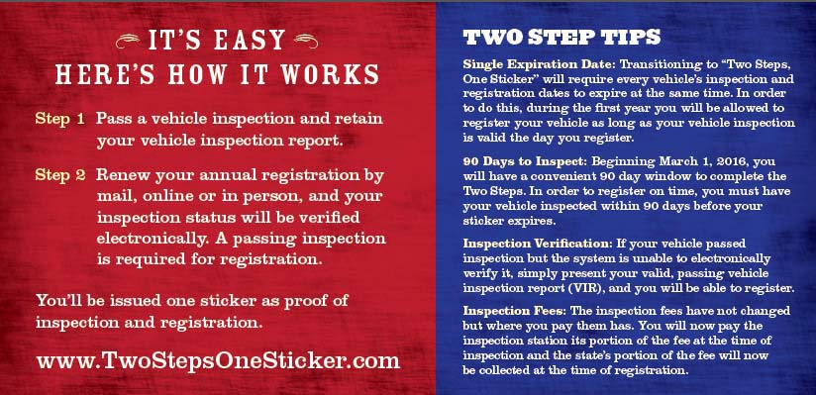
Registration Renewal Insert

Slide 18


Posters

Slide 19
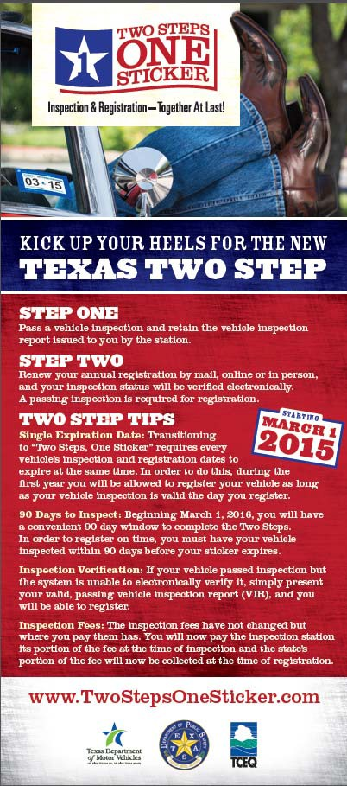


Push Cards & Bumper Sticker

Slide 20

Website Preview
www.TwoStepsOneSticker.com
20

Slide 21
Questions?
Have questions later? E‐mail your RSC and they will get you an answer.
21

